Slide 1
DL is more feasible when:

Slide 2
DL is more feasible when:
The task doesn’t require much thinking/reasoning
Lots of (supervised) data is available

Slide 3
Anything you can do without much thought,
DL can do.
Input | Output | Application
Audio | Text transcript | Speech Recognition
Music | Like/not like | Music Recommendation
Photo | Image identification | Computer Vision
English | Chinese | Translation
Text | Meaning | Sentiment Analysis

Slide 4
DL performs poorly when:
Trying to learn complex concepts from a small amount of data

Slide 5
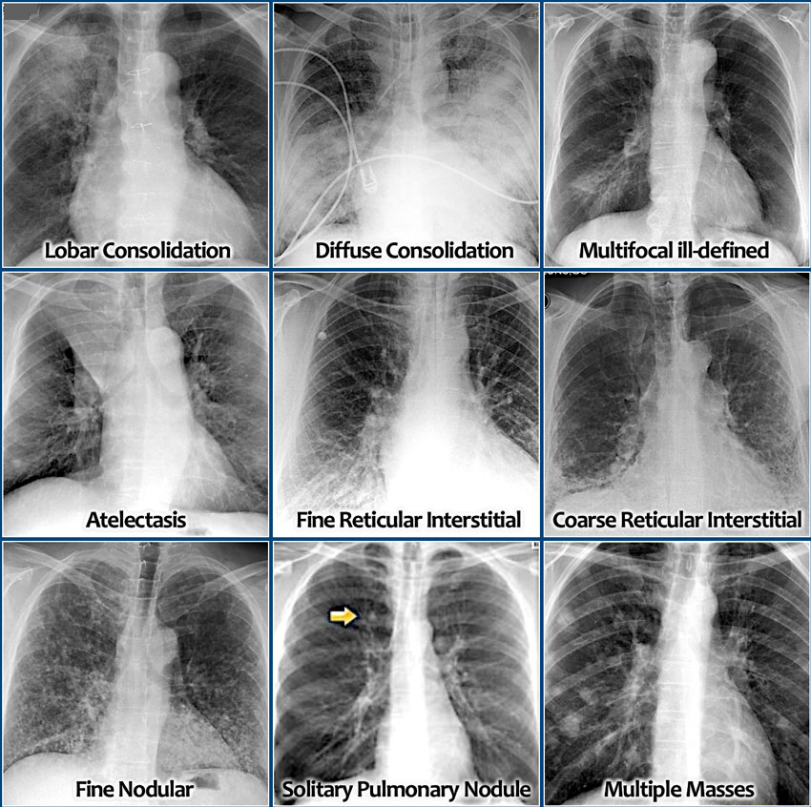

Slide 6
DL performs poorly when:
Performing a task on new types of data

Slide 7
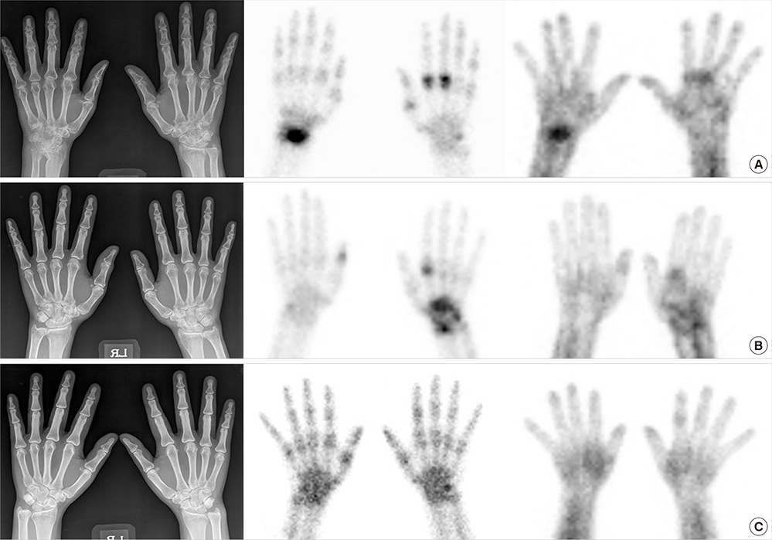

Slide 8
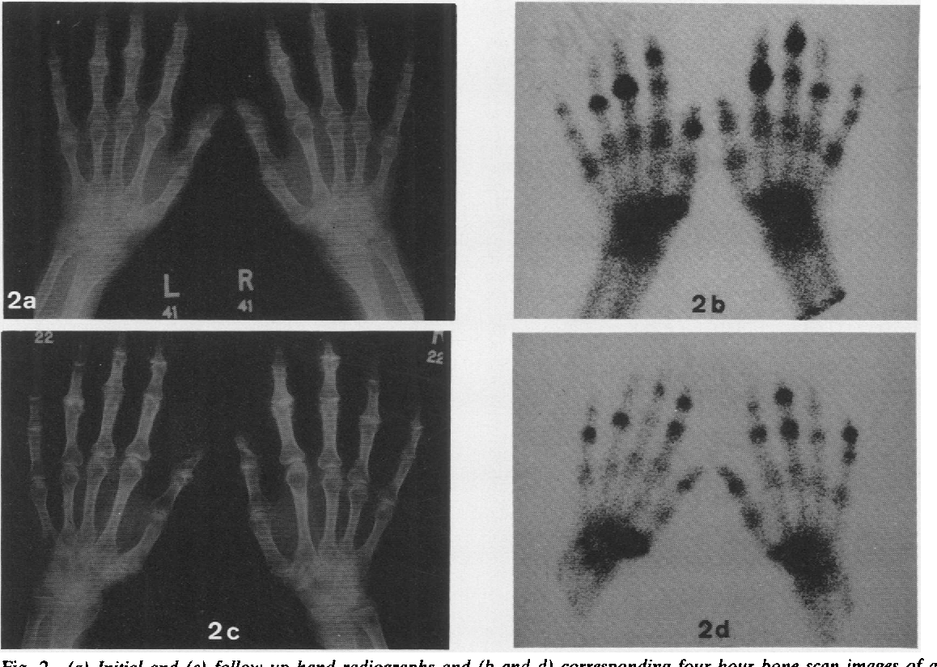

Slide 9
What DL can do

Slide 10
Computer Vision

Slide 11
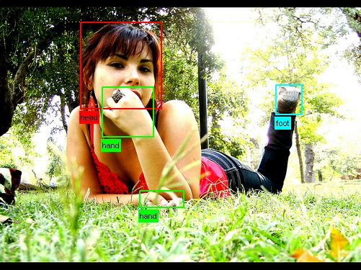
Understanding what’s in an Image

Slide 12

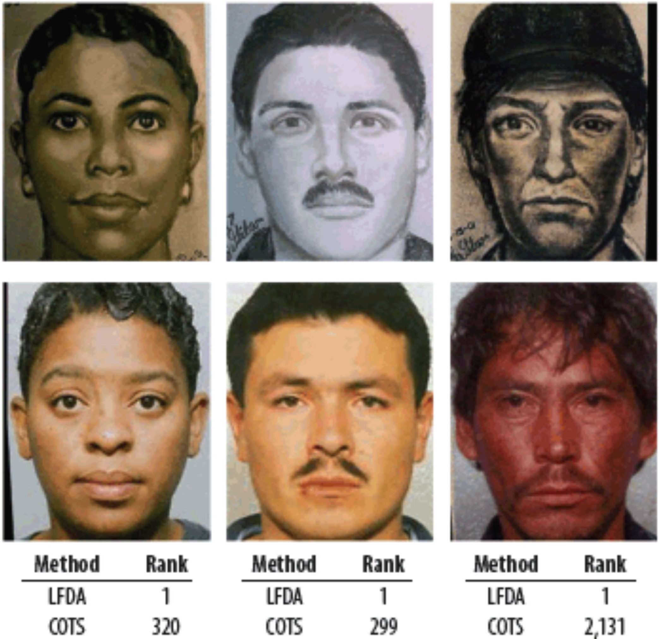

Slide 13


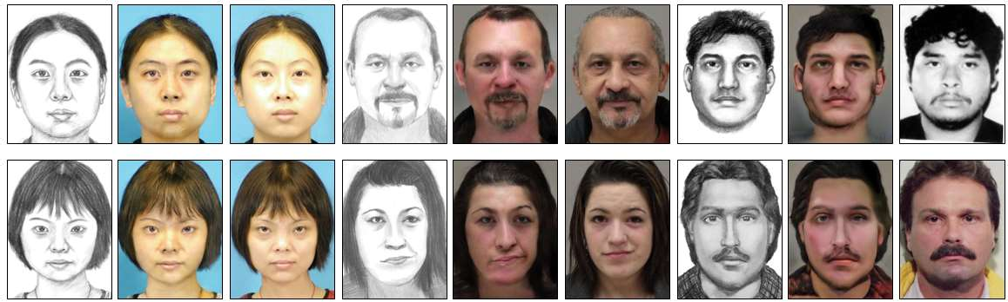

Slide 14
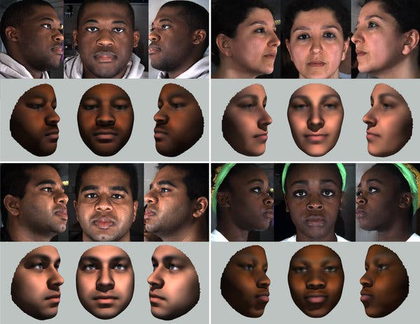

Slide 15
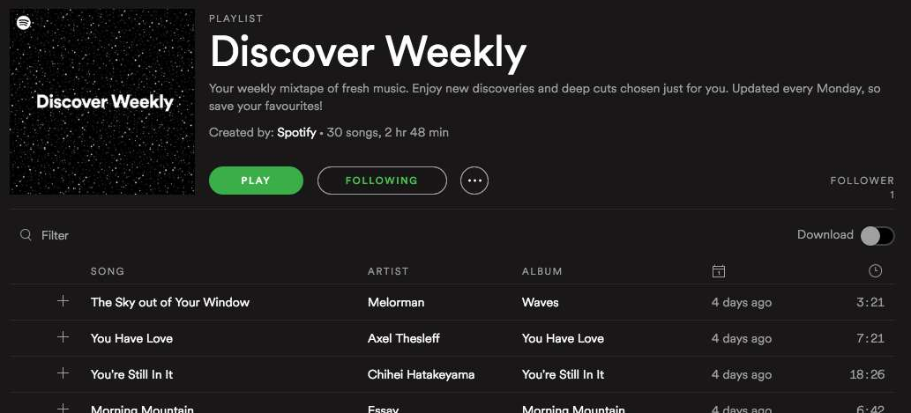

Slide 16
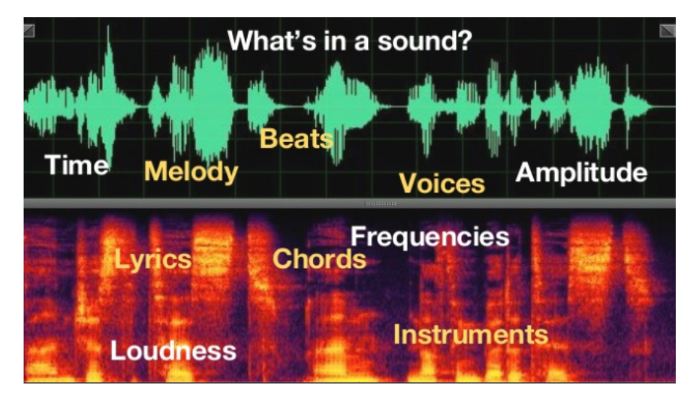

Slide 17
Natural Language Processing

Slide 18
Sentiment Recognition

Slide 19
Sentiment Recognition
We enjoyed the food and the service was great.

Slide 20
Sentiment Recognition
We enjoyed the food and the service was great.

Slide 21
Sentiment Recognition
We enjoyed the food and the service was great.
We had to wait for an excessive amount of time and our order was wrong.

Slide 22
Sentiment Recognition
We enjoyed the food and the service was great.
We had to wait for an excessive amount of time and our order was wrong.

Slide 23
Informational Retrieval

Slide 24
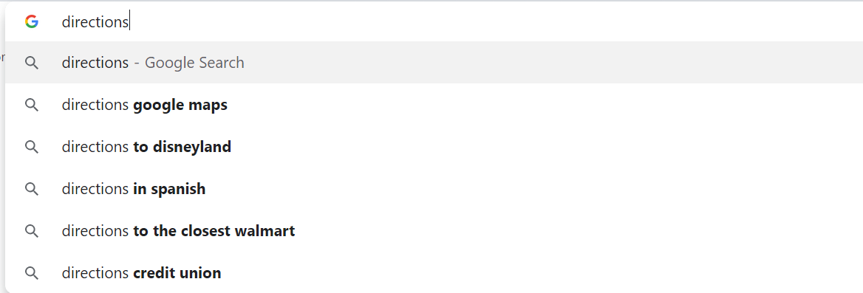
Informational Retrieval

Slide 25
Machine Translation

Slide 26
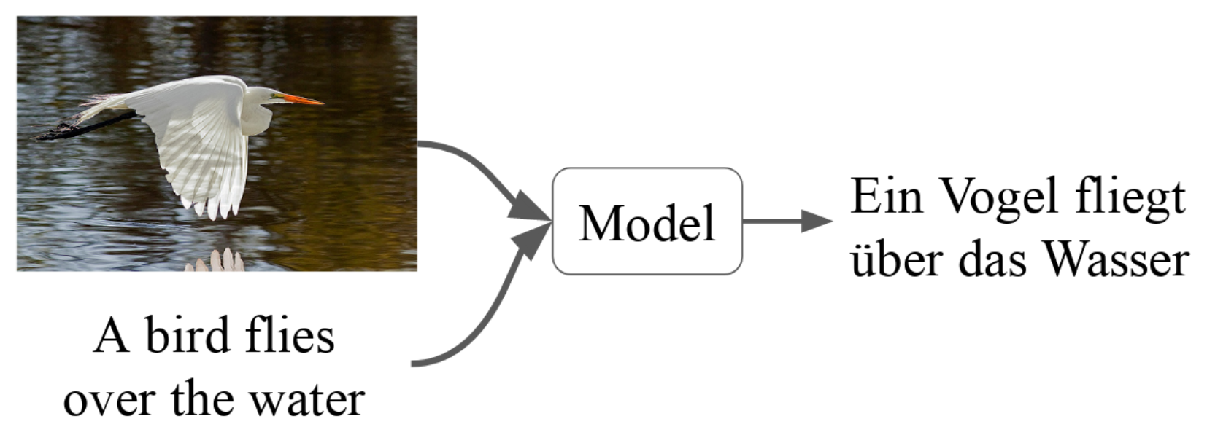
Machine Translation

Slide 27
你好
English
Chinese
Hello
再見
Goodbye

Slide 28
Speech

Slide 29
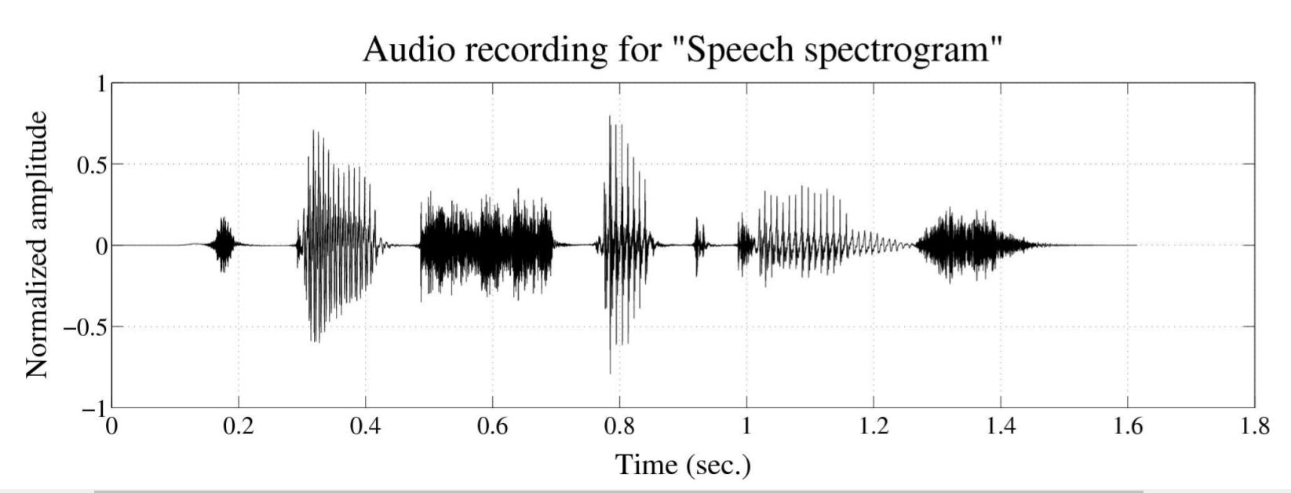
Speech Recognition
(speech-to-text)

Slide 30
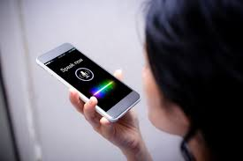
Speaker ID

Slide 31
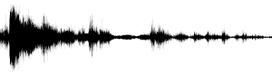
Speech Synthesis
(text-to-speech)
Data is the new oil.

Slide 33
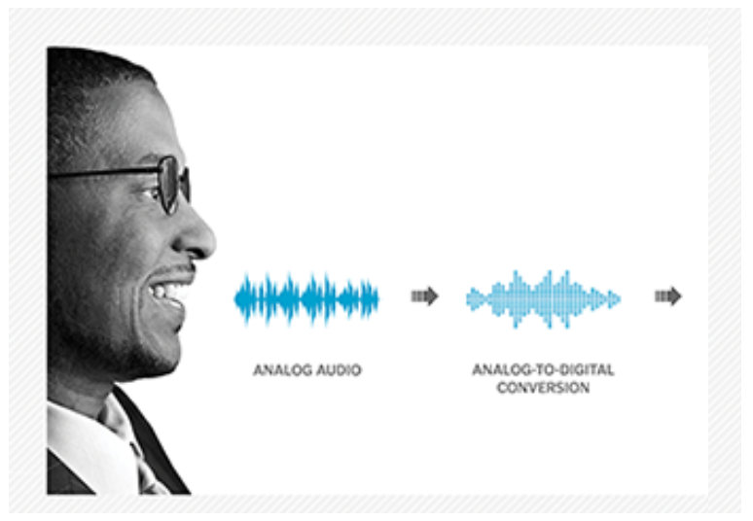
Recognizing Race by Voice

